Slide 1

INSTITUTE : UIE
DEPARTMENT : CSE
Bachelor of Engineering (Computer Science & Engineering)
Mobile Application Development(20CST-355)
TOPIC OF PRESENTATION:
Introduction to Setting up the mobile apps development environment with emulator Telephony
Prepared by:
Parveen Kumar Saini(E13339)
DISCOVER . LEARN . EMPOWER

Slide 2
Introduction to Setting up the mobile apps development environment with emulator Telephony

Slide 3
TOOLS
There are four tools that you will need and they are available on the Internet for free:
Java JDK5 or JDK6
Android SDK
Eclipse IDE for Java Developers (optional)
Android Development Tools (ADT) Eclipse Plugin (optional)

Slide 4
Step 1: Setup Java Development Kit (JDK) You can download the JDK and install it, which is pretty easy. ...
Step 2: Configure Android SDK. ...
Step 3: Setup Eclipse IDE. ...
Step 4: Setup Android Development Tools (ADT) Plugin. ...
Step 5: Create Android Virtual Device. ...
8 comments.

Slide 5
Step 1: Setup Java Development Kit (JDK)
You can download the JDK and install it, which is pretty easy. After that, you just have to set PATH and JAVA_HOME variables to the folder where you have java and javac.
Note for Windows Users: If you installed the JDK in C:\jdk1.6.0_15 then you will have to add the following two lines in your C:\autoexec.bat file.
Set PATH=C:\jdk1.6.0_15\bin;%PATH%
set JAVA_HOME=C:\jdk1.6.0_15

Slide 6
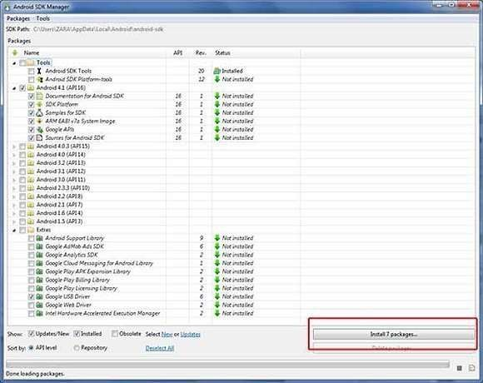
Step 2: Configure Android SDK After you have successfully installed the Android SDK, it is time to configure it. After installing the Android SDK, you will get a window like this:

Slide 7
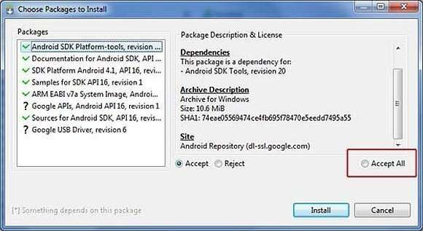
Just de-select the Documentation for Android SDK and Samples for SDK packages if you want to reduce the installation size and time. Click on Install 7 packages to continue with the installation. You will get a dialogue box like this

Slide 8
It will take some time to install, so in the meanwhile you could do some other task to kill the time.
How long will it take?
Well, it depends on the speed of your Internet connection. Once it is done, you can close the SDK manager.

Slide 9
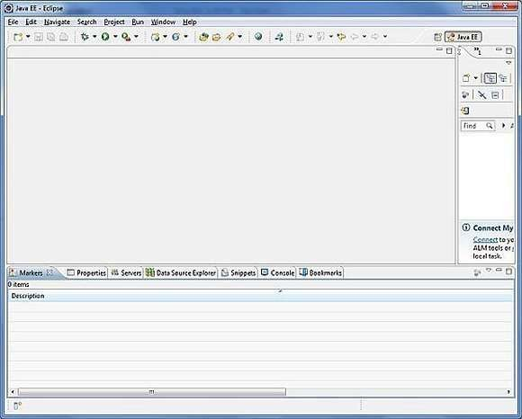
Step 3: Setup Eclipse IDE
Install the latest version of Eclipse. After successful installation, it should display a window like this

Slide 10
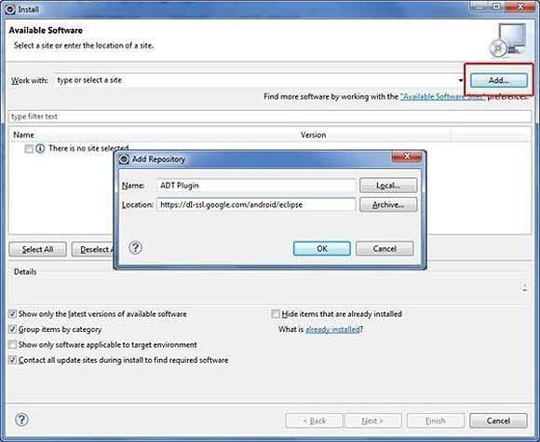
Step 4: Setup Android Development Tools(ADT) Plugin Here you will learn to install the Android Development Tool plugin for Eclipse. To do this, you have to click on Help > Software Updates > Install New Software. This will display the following dialogue box

Slide 11
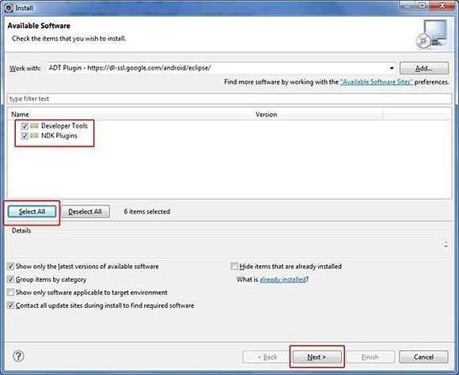
Just click on the Add button as shown in the picture and add https://dl- ssl.google.com/android/eclipse/ as the location. When you press OK, Eclipse will start to search for the required plug-in and finally it will list the found plug- ins.

Slide 12
Step 5: Create Android Virtual Device
The last step is to create Android Virtual Device, which you will use to test your Android applications.
To do this, open Eclipse and Launch Android AVD Manager from options Wi ndow > AVD Manager and click on new which will create a successful android virtual device.

Slide 13
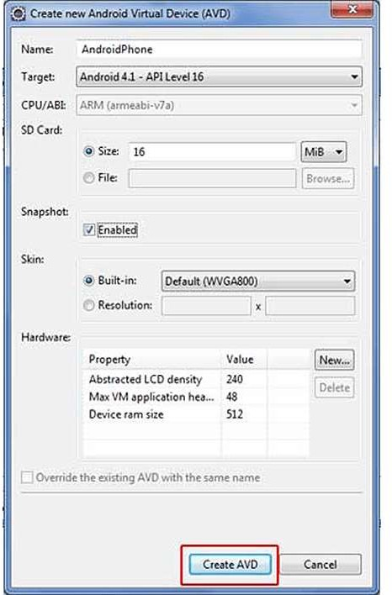

Slide 14
Before we write the code, you need to know how to take input from the user. The most efficient way of taking input from the user is to use the Scanner class, which is found in the java.io package as it is just a two-step process.
Scanner scanner = new Scanner(System.in); String input = scanner.next();
/* or String input = (new Scanner(System.in)).next(); */
I recommend using the Scanner class because it works equally well on command line as well as with Eclipse that we will use to make the Rock Paper Scissors app.

Slide 15
THANK YOU
For queries
Email: parveen.e13339@cumail.in

